Slide 1
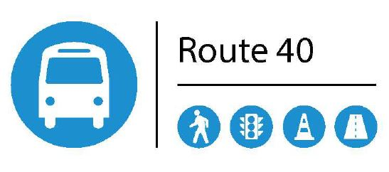
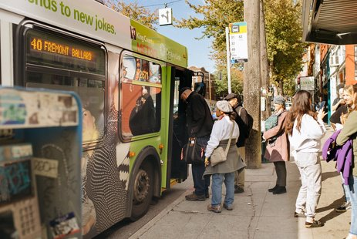
Agenda
Introductions
Route 40 Background ​
Westlake ​Concepts
Questions
Notes:
Christa
Before we get started I'd like to walk through the agenda for this presentation. We’ll start with a few introductions before diving into the background of the Route 40 project. We'll then move to focus the discussion on the proposed improvements along the Route 40 corridor located on Westlake Ave and the South Lake Union area. We'll finish this presentation by talking about the next steps and take your questions.

Slide 2
Route 40 Transit-Plus Multimodal Corridor Project
Mercer Corridor Stakeholder Committee
November 2, 2023

Slide 3
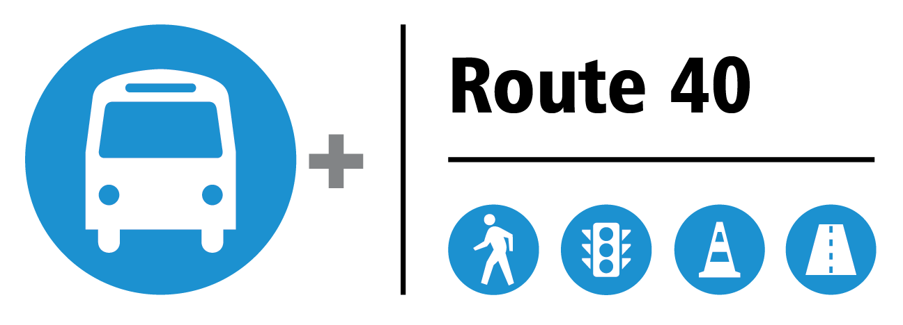
Background: CORRIDOR OVERVIEW
3
6
Route 40 TPMC Project
Notes:
Running north to south, the Route 40 is 13.5 miles long and passes through the neighborhoods of Northgate, Crown Hill, Loyal Heights, Ballard, Fremont, South Lake Union, Downtown Seattle, and Pioneer Square. Our map here has the Route 40 oriented with north to the left to better fit on the slide.
The Route provides key connections within our transit system including to the RapidRide C, D, E, Route 44, Northgate transit center, and future light rail in Ballard. Route 40 buses are scheduled to arrive every 5 to 10 minutes during peak periods and stops are located approximately every quarter mile throughout the route.
The yellow areas on the map indicate where improvements have been identified for the Route 40 TPMC project. The orange lines indicate where we are planning to install bus lanes or change the lane configuration on the street.
Brian

Slide 4
Project Objectives​
Make bus trips faster and more reliable, now and in the future​
Make it safer and easier to access transit​
Respond to community needs and priorities​
Fulfill Levy to Move Seattle commitments​
Notes:
Josh
The Route 40 Transit Plus Multimodal Corridor project was identified as part of the Levy to Move Seattle and King County Metro's METRO CONNECTS program.
The primary objective of the Route 40 TPMC project is to make transit trips for transit users more competitive and more reliable.
Our project goals are to:
Reduce transit travel times by 5% to 10% during peak periods
Improve service reliability by reducing headway variability during peak periods
Another concurrent project objective is to make it easier and safer to access transit as well as board and deboard at bus stops. Our team is also responding to community needs and priorities, as we learn them through our outreach process.

Slide 5
Project Funding
The Route 40 project is well underway and is scheduled to start construction in 2024. State and federal agencies have identified the Route 40 project – along with RapidRide J in Eastlake and RapidRide G on Madison St – as high priorities.
Funding Source | Funding Amount
Move Seattle Levy | $7.7M
Local Sources | $0.1M
Connecting Washington | $3.8M
Federal Grants | $4.0M
King County Metro Partnership | $4.4M
Seattle Transportation Benefit District (STBD) Vehicle Licensing Fee (VLF) | $0.5M
Regional Mobility Grant (RMG) | $6.0M
Total Budget | $26.5M
Notes:
The Route 40 TPMC project has a budget of $26.5 million coming from multiple funding sources including the Levy to Move Seattle, federal and state grants, King County Metro partnership funds, and the Seattle Transportation Benefit District Vehicle Licensing Fee.
Significant amount will be going to construction. Not including contingency.
Federal Grants have obligation deadlines and funds need to be spend otherwise we will lose the funding
Brian

Slide 6
Project Schedule
Approaching
1OO% Design – Fall 2023
Approaching
60% Design
Notes:
The project is approaching 60% design phase.
Currently, we anticipate completing design and beginning construction in late 2023.
Construction is expected to take roughly one year, wrapping up in 2024.
Public Involvement is taking place throughout all the project phases.

Slide 7
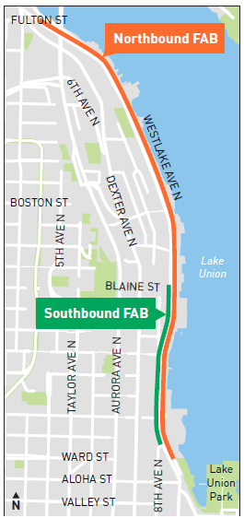
Pilot Freight and Bus Lane Project
This pilot will allow freight trucks over 26,000 lbs (13T) to use bus lanes. No stopping or loading will be permitted
Metro operates approximately 6 buses per hour in each direction on Westlake Ave
The lane will be in effect 24/7
Cyclists are encouraged to use the parallel bike path on the east side of Westlake Ave
SB Freight vehicles will merge into general purpose lane north of Westlake/9th
University of Washington Freight Lab will evaluate the pilot
Notes:
Josh
This graphic is an overview of the proposed improvements along Westlake Avenue.
On the north end of the segment, the project proposes a minor bicycle facility improvement to create a southbound bike lane approaching Nickerson Street and to install a bike box for cyclists continuing to the protected bike lanes on Dexter Avenue. In addition, new accessible pedestrian signals are proposed at Galer Street and Halladay Street. The new concrete pads proposed at southbound bus stops along Westlake will help to reduce pavement failures.
The red line highlights where new designated bus lanes are proposed in both directions.

Slide 8
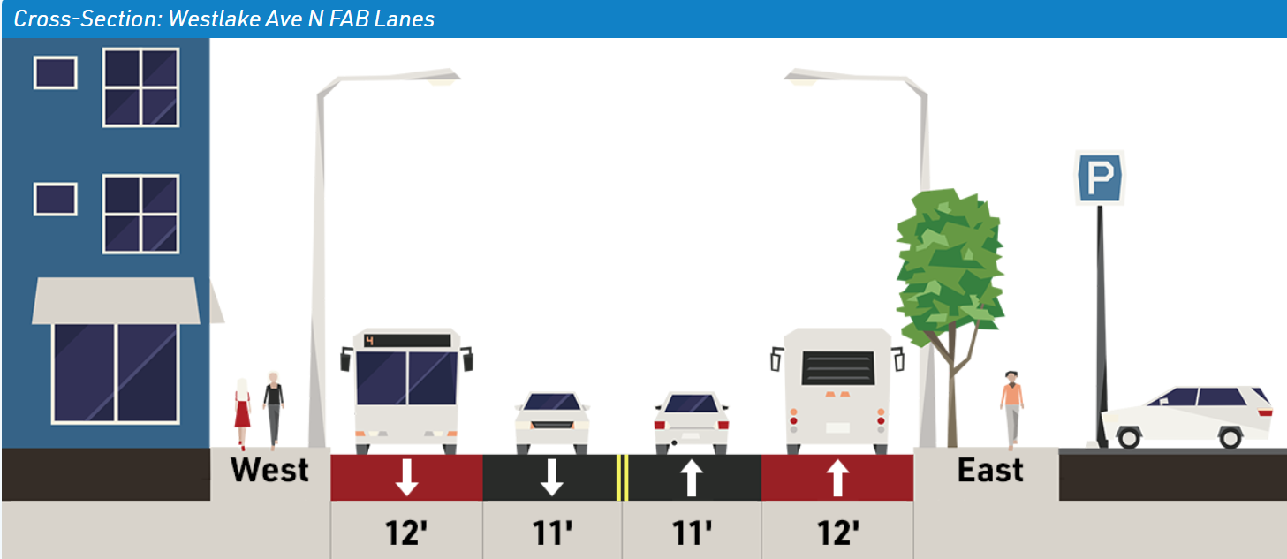
Westlake Ave Bus Lanes between 9th Ave N and Fremont Bridge
Proposed Changes
Bus lane in both directions
Lane widths remain as existing
Expected Benefits
Reduced transit travel times and improved reliability in both directions
Existing
West
East
Proposed
Notes:
Josh
This slide is unchanged from our last presentation, but as we focus on the Westlake Avenue bus lanes, the top half of the graphic illustrates a cross-section of the existing four-lane roadway and the bottom half of the graphic illustrates the proposed layout.
We are proposing converting the curbside lanes into bus only lanes in both directions. Expected benefits include reduced transit travel times and improved service reliability, especially during peak periods. In addition, northbound buses will always be at the front of the queue to cross the Fremont Bridge after bridge openings.

Slide 9
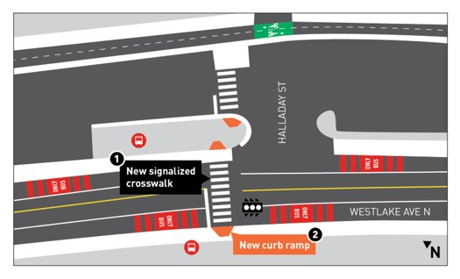
Westlake Ave N and N Halladay St
Proposed Changes
New signalized pedestrian crossing
Expected Benefits
Increase safety and bus access
Notes:
Josh
This pedestrian signal is new from our last presentation and has been requested by the community for over 9 years. SDOT and King County Metro have worked together to implement this pedestrian signal at Halladay Street. The SDOT traffic operations department supported this pedestrian signal based upon new Enhanced Pedestrian Crossing location guidelines, observed vehicle speeds much higher than the 25mph speed limit, and vehicle volumes on the corridor. There will be a new southbound bus stop paired with the relocation of the northbound bus stop, which will be relocated south approximately 700 feet. Additional survey and door-to-door outreach will be completed as this design is progressed.

Slide 10
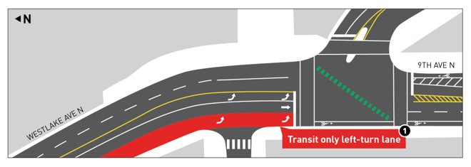
Westlake Ave and 9th Ave
Proposed Changes
Install southbound transit only left-turn lane and signal phase
FAB Lane Queue jump at Highland Dr to facilitate southbound transit movements
Expected Benefits
Reduced transit travel times and improved reliability
Notes:
Josh
Next we will review the design at Westlake and 9th. Based upon feedback from our last presentation, we have updated the design concept to maintain the location of the left turn lane used by general purpose traffic; we had initially proposed a dual left turn with one dedicated to transit. The curbside lane will now be a transit only left turn with a dedicated left turn signal phase. The queue jump at Highland Drive to the north will work in conjunction with this dedicated left turn phase to efficiently move buses southbound towards Mercer Street.

Slide 11
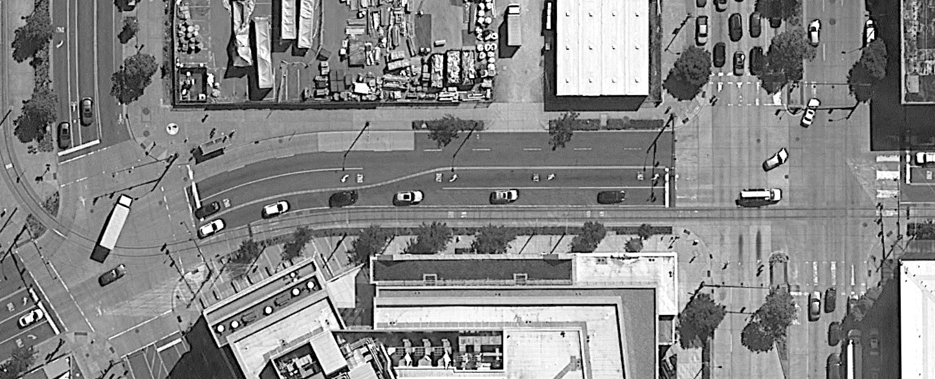
Westlake Ave Marking Modification between Valley St and Mercer St
Valley St
Mercer St
Westlake Ave N
N
Notes:
Josh
The last item that we wanted to highlight with your group is a proposed marking modification on Westlake Ave between Valley St or Roy St and Mercer St. This slide is unchanged from our last presentation. This change would increase the length of the southbound left-turn pocket, taking that space from the northbound pocket. This creates more storage space for the heavier southbound left-turn volumes and will help reduce spill-over events which can block the southbound thru traffic.

Slide 12
Comments/Questions?​ ​ Route40@seattle.gov​ http://www.seattle.gov/transportation/route40​
Notes:
Christa
Thank you very much for attending today’s presentation. We will continue to reach out to local property owners, businesses, and residents as move forward in the design process. We have an online open house that will go live on Tuesday May 31st and be up for 3 weeks. We encourage you to participate and you can find the link on our project webpage. We also encourage you to sign up for our project listserv through the project webpage so that you receive project updates.
We have some time now to take your questions, but you can also email questions and comments to Route40@seattle.gov or call (206) 775-8731. Thank you very much for your interest and participation!

